Slide 1
TABLE-1
Transaction | List of items
T1 | I1,I2,I3
T2 | I2,I3,I4
T3 | I4,I5
T4 | I1,I2,I4
T5 | I1,I2,I3,I5
T6 | I1,I2,I3,I4

Slide 2
1. Count of Each Item
TABLE-2
Transaction | List of items
T1 | I1,I2,I3
T2 | I2,I3,I4
T3 | I4,I5
T4 | I1,I2,I4
T5 | I1,I2,I3,I5
T6 | I1,I2,I3,I4
Item | Count
I1 | 4
I2 | 5
I3 | 4
I4 | 4
I5 | 2
=>

Slide 3
Support threshold=50%, Confidence= 60%
Support threshold=50%
=> 0.5*6= 3
=> min_sup=3

Slide 4
2. Prune Step: TABLE -2 shows that I5 item does not meet min_sup=3, thus it is deleted, only I1, I2, I3, I4 meet min_sup count.
TABLE-3
Item | Count
I1 | 4
I2 | 5
I3 | 4
I4 | 4
I5 | 2
Item | Count
I1 | 4
I2 | 5
I3 | 4
I4 | 4
=>

Slide 5
3. Join Step: Form 2-itemset. From TABLE-1 find out the occurrences of 2-itemset. TABLE-4
Item | Count
I1,I2 | 4
I1,I3 | 3
I1,I4 | 2
I2,I3 | 4
I2,I4 | 3
I3,I4 | 2
Item | Count
I1 | 4
I2 | 5
I3 | 4
I4 | 4
=>

Slide 6
4. Prune Step: TABLE -4 shows that item set {I1, I4} and {I3, I4} does not meet min_sup, thus it is deleted.
TABLE-5
Item | Count
I1,I2 | 4
I1,I3 | 3
I1,I4 | 2
I2,I3 | 4
I2,I4 | 3
I3,I4 | 2
Item | Count
I1,I2 | 4
I1,I3 | 3
I2,I3 | 4
I2,I4 | 3
=>

Slide 7
5. Join and Prune Step:
TABLE-6
Item | Count
I1,I2 | 4
I1,I3 | 3
I2,I3 | 4
I2,I4 | 3
Item
I1,I2,I3
I1,I2,I4
I1,I3,I4
I2,I3,I4
Item | Count
I1,I2,I3 | 3
I1,I2,I4 | 1
I1,I3,I4 | 1
I2,I3,I4 | 2
=>
=>
Only {I1, I2, I3} is frequent.

Slide 8
5. Join and Prune Step:
Form 3-itemset.
From the TABLE- 1 find out occurrences of 3-itemset.
From TABLE-5, find out the 2-itemset subsets which support min_sup.
For the itemset {I1, I2, I3} subsets, {I1, I2}, {I1, I3}, {I2, I3} are occurring in TABLE-5 thus {I1, I2, I3} is frequent.
For the itemset {I1, I2, I4} subsets, {I1, I2}, {I1, I4}, {I2, I4}, {I1, I4} is not frequent, as it is not occurring in TABLE-5 thus {I1, I2, I4} is not frequent, hence it is deleted.
Only {I1, I2, I3} is frequent.

Slide 9
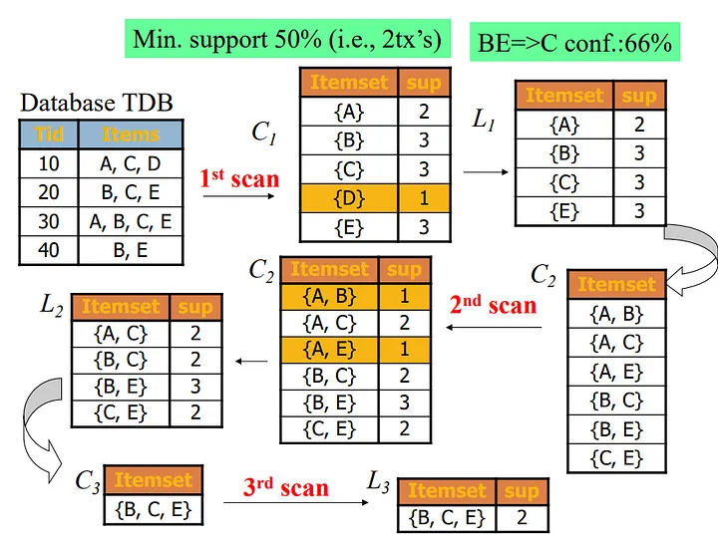

Slide 10
TABLE-1
Transaction | List of items
T1 | Bread,Butter,Milk
T2 | Bread,Butter
T3 | Beaar,Cookies,Diapers
T4 | Milk,Diapers,Bread,Butter
T5 | Bear, Diapers
Support =40%, Confidence= 70%
Support = 40%
=> 0.4*5= 2
=> min_sup=2

Slide 11
6. Generate Association Rules:
From the frequent itemset discovered above the association could be:
{I1, I2} => {I3}
Confidence = support {I1, I2, I3} / support {I1, I2} = (3/ 4)* 100 = 75%
{I1, I3} => {I2}
Confidence = support {I1, I2, I3} / support {I1, I3} = (3/ 3)* 100 = 100%
{I2, I3} => {I1}
Confidence = support {I1, I2, I3} / support {I2, I3} = (3/ 4)* 100 = 75%
{I1} => {I2, I3}
Confidence = support {I1, I2, I3} / support {I1} = (3/ 4)* 100 = 75%
{I2} => {I1, I3}
Confidence = support {I1, I2, I3} / support {I2 = (3/ 5)* 100 = 60%
{I3} => {I1, I2}
Confidence = support {I1, I2, I3} / support {I3} = (3/ 4)* 100 = 75%
This shows that all the above association rules are strong if minimum confidence threshold is 60%.

Slide 12
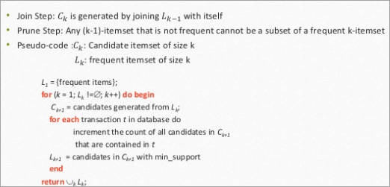
The Apriori Algorithm: Pseudo Code
C: Candidate item set of size k
L: Frequent itemset of size k

Slide 13

U19ITT53 - Data Warehousing and Data Mining III Year / V Semester

Slide 14

Pre Requisite

Slide 15
Course Outcomes
CO1 - Describe a data warehouse (K2)
CO2 - Apply pre-processing techniques (K3)
CO3 - Interpret correlation based frequent patterns in large data sets (K2)
CO4 - Compare and contrast the various classifiers (K2)
CO5 - Apply data mining techniques and methods to large data sets (K3)

Slide 16
UNIT III
UNIT III – ASSOCIATION RULE MINING
Association Rule Mining: Basic concepts- Frequent item set mining methods: Apriori algorithm- A pattern growth approach for mining frequent item sets
Pattern evaluation methods- Mining multilevel, multi-dimensional space constraint based frequent pattern mining.

Slide 17
Association Rule Mining – Basic Concepts
Association rule mining is a type of unsupervised mining technique that checks for the dependency of one data item on another data item and maps accordingly so that it can be more profitable.
It used to find some interesting relations or associations among the variables of dataset.
It is based on different rules to discover the interesting relations between variables in the database.
Used in Market Basket analysis, Web usage mining, continuous production,
In market basket analysis - to discover the associations between items -all products that are purchased together are put together.

Slide 18
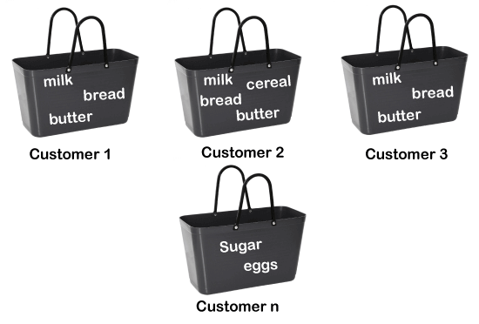
For example, if a customer buys bread, he most likely can also buy butter, eggs, or milk, so these products are stored within a shelf or mostly nearby.

Slide 19
Association rule Mining can be divided into three types of algorithms:
Apriori
Eclat
F-P Growth Algorithm

Slide 20

How does Association Rule Mining work?
Association rule mining works on the concept of If and Else Statement, such as if A then B.
if element is called antecedent,
then statement is called as Consequent.
These types of relationships - find out some association or relation between two items is known as single cardinality.
It is all about creating rules, and if the number of items increases, then cardinality also increases accordingly.
To measure the associations between thousands of data items, there are several metrics.
These metrics are given below:
Support
Confidence
Lift

Slide 21
These metrics are given below:
Support
Confidence
Lift

Slide 22
Support
Support is the frequency of A or how frequently an item appears in the dataset.
It is defined as the fraction of the transaction T that contains the itemset X.
If there are X datasets, then for transactions T, it can be written as:

Slide 23
Confidence
Confidence indicates how often the rule has been found to be true.
Or how often the items X and Y occur together in the dataset when the occurrence of X is already given.
It is the ratio of the transaction that contains X and Y to the number of records that contain X.

Slide 24
Lift
It is the strength of any rule, which can be defined as below formula:
It is the ratio of the observed support measure and expected support if X and Y are independent of each other.
It has three possible values:
If Lift= 1: The probability of occurrence of antecedent and consequent is independent of each other.
Lift>1: It determines the degree to which the two itemsets are dependent to each other.
Lift<1: It tells us that one item is a substitute for other items, which means one item has a negative effect on another.

Slide 25
Types of Association Rule Mining
Association rule Mining can be divided into three algorithms:
Apriori Algorithm
This algorithm uses frequent datasets to generate association rules. It is designed to work on the databases that contain transactions. This algorithm uses a breadth-first search and Hash Tree to calculate the itemset efficiently.
It is mainly used for market basket analysis and helps to understand the products that can be bought together. It can also be used in the healthcare field to find drug reactions for patients.
Eclat Algorithm
Eclat algorithm stands for Equivalence Class Transformation. This algorithm uses a depth-first search technique to find frequent itemsets in a transaction database. It performs faster execution than Apriori Algorithm.
F-P Growth Algorithm
The F-P growth algorithm stands for Frequent Pattern, and it is the improved version of the Apriori Algorithm. It represents the database in the form of a tree structure that is known as a frequent pattern or tree. The purpose of this frequent tree is to extract the most frequent patterns.

Slide 26
Applications of Association Rule Mining
It has various applications in machine learning and data mining. Below are some popular applications of association rule mining:
Market Basket Analysis: It is one of the popular examples and applications of association rule mining. This technique is commonly used by big retailers to determine the association between items.
Medical Diagnosis: With the help of association rules, patients can be cured easily, as it helps in identifying the probability of illness for a particular disease.
Protein Sequence: The association rules help in determining the synthesis of artificial Proteins.
It is also used for the Catalog Design and Loss-leader Analysis and many more other applications.

Slide 27
What Is An Itemset?
A set of items together is called an itemset.
If any itemset has k-items it is called a k-itemset.
An itemset consists of two or more items.
An itemset that occurs frequently is called a frequent itemset.
Thus frequent itemset mining is a data mining technique to identify the items that often occur together.
For Example, Bread and butter, Laptop and Antivirus software, etc.

Slide 28
What Is A Frequent Itemset?
A set of items is called frequent if it satisfies a minimum threshold value for support and confidence. Support shows transactions with items purchased together in a single transaction. Confidence shows transactions where the items are purchased one after the other.
For frequent itemset mining method, we consider only those transactions which meet minimum threshold support and confidence requirements. Insights from these mining algorithms offer a lot of benefits, cost-cutting and improved competitive advantage.
There is a tradeoff time taken to mine data and the volume of data for frequent mining. The frequent mining algorithm is an efficient algorithm to mine the hidden patterns of itemsets within a short time and less memory consumption.

Slide 29
Frequent Pattern Mining (FPM)
The frequent pattern mining algorithm is one of the most important techniques of data mining to discover relationships between different items in a dataset. These relationships are represented in the form of association rules. It helps to find the irregularities in data.
FPM has many applications in the field of data analysis, software bugs, cross-marketing, sale campaign analysis, market basket analysis, etc.
Frequent itemsets discovered through Apriori have many applications in data mining tasks. Tasks such as finding interesting patterns in the database, finding out sequence and Mining of association rules is the most important of them.
Association rules apply to supermarket transaction data, that is, to examine the customer behavior in terms of the purchased products. Association rules describe how often the items are purchased together.

Slide 30
Association Rules
Association Rule Mining is defined as:
“Let I= { …} be a set of ‘n’ binary attributes called items. Let D= { ….} be set of transaction called database. Each transaction in D has a unique transaction ID and contains a subset of the items in I. A rule is defined as an implication of form X->Y where X, Y? I and X?Y=?. The set of items X and Y are called antecedent and consequent of the rule respectively.”
Learning of Association rules is used to find relationships between attributes in large databases. An association rule, A=> B, will be of the form” for a set of transactions, some value of itemset A determines the values of itemset B under the condition in which minimum support and confidence are met”.

Slide 31
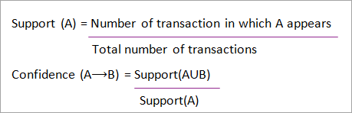
Support and Confidence can be represented by the following example:
Bread=> butter [support=2%, confidence-60%]
The above statement is an example of an association rule. This means that there is a 2% transaction that bought bread and butter together and there are 60% of customers who bought bread as well as butter.
Support and Confidence for Itemset A and B are represented by formulas:

Slide 32
Association rule mining consists of 2 steps:
Find all the frequent itemsets.
Generate association rules from the above frequent itemsets.
Why Frequent Itemset Mining?
Frequent itemset or pattern mining is broadly used because of its wide applications in mining association rules, correlations and graph patterns constraint that is based on frequent patterns, sequential patterns, and many other data mining tasks.
Apriori Algorithm – Frequent Pattern Algorithms
Apriori algorithm was the first algorithm that was proposed for frequent itemset mining. It was later improved by R Agarwal and R Srikant and came to be known as Apriori. This algorithm uses two steps “join” and “prune” to reduce the search space. It is an iterative approach to discover the most frequent itemsets.

Slide 33
Apriori says:
The probability that item I is not frequent is if:
P(I) < minimum support threshold, then I is not frequent.
P (I+A) < minimum support threshold, then I+A is not frequent, where A also belongs to itemset.
If an itemset set has value less than minimum support then all of its supersets will also fall below min support, and thus can be ignored. This property is called the Antimonotone property.
The steps followed in the Apriori Algorithm of data mining are:
Join Step: This step generates (K+1) itemset from K-itemsets by joining each item with itself.
Prune Step: This step scans the count of each item in the database. If the candidate item does not meet minimum support, then it is regarded as infrequent and thus it is removed. This step is performed to reduce the size of the candidate itemsets.

Slide 34
Steps In Apriori
Apriori algorithm is a sequence of steps to be followed to find the most frequent itemset in the given database. This data mining technique follows the join and the prune steps iteratively until the most frequent itemset is achieved. A minimum support threshold is given in the problem or it is assumed by the user.
#1) In the first iteration of the algorithm, each item is taken as a 1-itemsets candidate. The algorithm will count the occurrences of each item.
#2) Let there be some minimum support, min_sup ( eg 2). The set of 1 – itemsets whose occurrence is satisfying the min sup are determined. Only those candidates which count more than or equal to min_sup, are taken ahead for the next iteration and the others are pruned.
#3) Next, 2-itemset frequent items with min_sup are discovered. For this in the join step, the 2-itemset is generated by forming a group of 2 by combining items with itself.

Slide 35
#4) The 2-itemset candidates are pruned using min-sup threshold value. Now the table will have 2 –itemsets with min-sup only.
#5) The next iteration will form 3 –itemsets using join and prune step. This iteration will follow antimonotone property where the subsets of 3-itemsets, that is the 2 –itemset subsets of each group fall in min_sup. If all 2-itemset subsets are frequent then the superset will be frequent otherwise it is pruned.
#6) Next step will follow making 4-itemset by joining 3-itemset with itself and pruning if its subset does not meet the min_sup criteria. The algorithm is stopped when the most frequent itemset is achieved

Slide 36
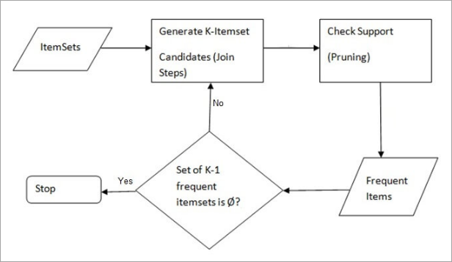

Slide 37
Example of Apriori: Support threshold=50%, Confidence= 60%
TABLE-1
Solution:
Support threshold=50% => 0.5*6= 3 => min_sup=3
Transaction | List of items
T1 | I1,I2,I3
T2 | I2,I3,I4
T3 | I4,I5
T4 | I1,I2,I4
T5 | I1,I2,I3,I5
T6 | I1,I2,I3,I4

Slide 38
1. Count Of Each Item
TABLE-2
Item | Count
I1 | 4
I2 | 5
I3 | 4
I4 | 4
I5 | 2

Slide 39
2. Prune Step: TABLE -2 shows that I5 item does not meet min_sup=3, thus it is deleted, only I1, I2, I3, I4 meet min_sup count.
TABLE-3
Item | Count
I1 | 4
I2 | 5
I3 | 4
I4 | 4

Slide 40
3. Join Step: Form 2-itemset. From TABLE-1 find out the occurrences of 2-itemset. TABLE-4
Item | Count
I1,I2 | 4
I1,I3 | 3
I1,I4 | 2
I2,I3 | 4
I2,I4 | 3
I3,I4 | 2

Slide 41
4. Prune Step: TABLE -4 shows that item set {I1, I4} and {I3, I4} does not meet min_sup, thus it is deleted.
TABLE-5
Item | Count
I1,I2 | 4
I1,I3 | 3
I2,I3 | 4
I2,I4 | 3

Slide 42
5. Join and Prune Step: Form 3-itemset. From the TABLE- 1 find out occurrences of 3-itemset. From TABLE-5, find out the 2-itemset subsets which support min_sup.
We can see for itemset {I1, I2, I3} subsets, {I1, I2}, {I1, I3}, {I2, I3} are occurring in TABLE-5 thus {I1, I2, I3} is frequent.
We can see for itemset {I1, I2, I4} subsets, {I1, I2}, {I1, I4}, {I2, I4}, {I1, I4} is not frequent, as it is not occurring in TABLE-5 thus {I1, I2, I4} is not frequent, hence it is deleted.
TABLE-6
Only {I1, I2, I3} is frequent.
Item
I1,I2,I3
I1,I2,I4
I1,I3,I4
I2,I3,I4

Slide 43
6. Generate Association Rules: From the frequent itemset discovered above the association could be:
{I1, I2} => {I3}
Confidence = support {I1, I2, I3} / support {I1, I2} = (3/ 4)* 100 = 75%
{I1, I3} => {I2}
Confidence = support {I1, I2, I3} / support {I1, I3} = (3/ 3)* 100 = 100%
{I2, I3} => {I1}
Confidence = support {I1, I2, I3} / support {I2, I3} = (3/ 4)* 100 = 75%
{I1} => {I2, I3}
Confidence = support {I1, I2, I3} / support {I1} = (3/ 4)* 100 = 75%
{I2} => {I1, I3}
Confidence = support {I1, I2, I3} / support {I2 = (3/ 5)* 100 = 60%
{I3} => {I1, I2}
Confidence = support {I1, I2, I3} / support {I3} = (3/ 4)* 100 = 75%
This shows that all the above association rules are strong if minimum confidence threshold is 60%.

Slide 44
The Apriori Algorithm: Pseudo Code
C: Candidate item set of size k
L: Frequent itemset of size k

Slide 45
Advantages
Easy to understand algorithm
Join and Prune steps are easy to implement on large itemsets in large databases
Disadvantages
It requires high computation if the itemsets are very large and the minimum support is kept very low.
The entire database needs to be scanned.

Slide 46
Applications Of Apriori Algorithm
Some fields where Apriori is used:
In Education Field: Extracting association rules in data mining of admitted students through characteristics and specialties.
In the Medical field: For example Analysis of the patient’s database.
In Forestry: Analysis of probability and intensity of forest fire with the forest fire data.
Apriori is used by many companies like Amazon in the Recommender System and by Google for the auto-complete feature.
Conclusion
Apriori algorithm is an efficient algorithm that scans the database only once.
It reduces the size of the itemsets in the database considerably providing a good performance. Thus, data mining helps consumers and industries better in the decision-making process.

Slide 47
A pattern growth approach for mining frequent item sets FREQUENT PATTERN (FP) GROWTH METHOD
Shortcomings Of Apriori Algorithm
Using Apriori needs a generation of candidate itemsets. These itemsets may be large in number if the itemset in the database is huge.
Apriori needs multiple scans of the database to check the support of each itemset generated and this leads to high costs.
These shortcomings can be overcome using the FP growth algorithm.

Slide 48
Frequent Pattern Growth Algorithm
This algorithm is an improvement to the Apriori method. A frequent pattern is generated without the need for candidate generation. FP growth algorithm represents the database in the form of a tree called a frequent pattern tree or FP tree.
This tree structure will maintain the association between the itemsets. The database is fragmented using one frequent item. This fragmented part is called “pattern fragment”. The itemsets of these fragmented patterns are analyzed. Thus with this method, the search for frequent itemsets is reduced comparatively.
FP Tree
Frequent Pattern Tree is a tree-like structure that is made with the initial itemsets of the database. The purpose of the FP tree is to mine the most frequent pattern. Each node of the FP tree represents an item of the itemset.
The root node represents null while the lower nodes represent the itemsets. The association of the nodes with the lower nodes that is the itemsets with the other itemsets are maintained while forming the tree.

Slide 49
Frequent Pattern Algorithm
Input: A database DB, represented by FP-tree constructed according to Algorithm 1, and a minimum support threshold ?.
Output: The complete set of frequent patterns.
Method: call FP-growth(FP-tree, null).
Procedure FP-growth(Tree, a) {
(01) if Tree contains a single prefix path then { // Mining single prefix-path FP-tree
(02) let P be the single prefix-path part of Tree;
(03) let Q be the multipath part with the top branching node replaced by a null root;
(04) for each combination (denoted as ß) of the nodes in the path P do
(05) generate pattern ß ∪ a with support = minimum support of nodes in ß;
(06) let freq pattern set(P) be the set of patterns so generated;
}

Slide 50
(07) else let Q be Tree;
(08) for each item ai in Q do { // Mining multipath FP-tree
(09) generate pattern ß = ai ∪ a with support = ai .support;
(10) construct ß’s conditional pattern-base and then ß’s conditional FP-tree Tree ß;
(11) if Tree ß ≠ Ø then
(12) call FP-growth(Tree ß , ß);
(13) let freq pattern set(Q) be the set of patterns so generated;
}
(14) return(freq pattern set(P) ∪ freq pattern set(Q) ∪ (freq pattern set(P) × freq pattern set(Q)))
}

Slide 51
Example Of FP-Growth Algorithm
Support threshold=50%, Confidence= 60%
Table 1
Solution:
Support threshold=50% => 0.5*6= 3 => min_sup=3
Transaction | List of items
T1 | I1,I2,I3
T2 | I2,I3,I4
T3 | I4,I5
T4 | I1,I2,I4
T5 | I1,I2,I3,I5
T6 | I1,I2,I3,I4

Slide 52
1. Count of each item
Table 2
2. Sort the itemset in descending order.
Table 3
Item | Count
I1 | 4
I2 | 5
I3 | 4
I4 | 4
I5 | 2
Item | Count
I2 | 5
I1 | 4
I3 | 4
I4 | 4

Slide 53
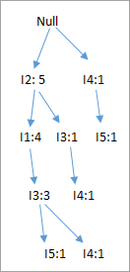
3. Build FP Tree
Considering the root node null.
The first scan of Transaction T1: I1, I2, I3 contains three items {I1:1}, {I2:1}, {I3:1}, where I2 is linked as a child to root, I1 is linked to I2 and I3 is linked to I1.
T2: I2, I3, I4 contains I2, I3, and I4, where I2 is linked to root, I3 is linked to I2 and I4 is linked to I3. But this branch would share I2 node as common as it is already used in T1.
Increment the count of I2 by 1 and I3 is linked as a child to I2, I4 is linked as a child to I3. The count is {I2:2}, {I3:1}, {I4:1}.
T3: I4, I5. Similarly, a new branch with I5 is linked to I4 as a child is created.
T4: I1, I2, I4. The sequence will be I2, I1, and I4. I2 is already linked to the root node, hence it will be incremented by 1. Similarly I1 will be incremented by 1 as it is already linked with I2 in T1, thus {I2:3}, {I1:2}, {I4:1}.
T5:I1, I2, I3, I5. The sequence will be I2, I1, I3, and I5. Thus {I2:4}, {I1:3}, {I3:2}, {I5:1}.
T6: I1, I2, I3, I4. The sequence will be I2, I1, I3, and I4. Thus {I2:5}, {I1:4}, {I3:3}, {I4 1}.

Slide 54
4. Mining of FP-tree is summarized below:
The lowest node item I5 is not considered as it does not have a min support count, hence it is deleted.
The next lower node is I4. I4 occurs in 2 branches , {I2,I1,I3:,I41},{I2,I3,I4:1}. Therefore considering I4 as suffix the prefix paths will be {I2, I1, I3:1}, {I2, I3: 1}. This forms the conditional pattern base.
The conditional pattern base is considered a transaction database, an FP-tree is constructed. This will contain {I2:2, I3:2}, I1 is not considered as it does not meet the min support count.
This path will generate all combinations of frequent patterns : {I2,I4:2},{I3,I4:2},{I2,I3,I4:2}
For I3, the prefix path would be: {I2,I1:3},{I2:1}, this will generate a 2 node FP-tree : {I2:4, I1:3} and frequent patterns are generated: {I2,I3:4}, {I1:I3:3}, {I2,I1,I3:3}.
For I1, the prefix path would be: {I2:4} this will generate a single node FP-tree: {I2:4} and frequent patterns are generated: {I2, I1:4}.
Item | Conditional Pattern Base | Conditional FP-tree | Frequent Patterns Generated
I4 | {I2,I1,I3:1},{I2,I3:1} | {I2:2, I3:2} | {I2,I4:2},{I3,I4:2},{I2,I3,I4:2}
I3 | {I2,I1:3},{I2:1} | {I2:4, I1:3} | {I2,I3:4}, {I1:I3:3}, {I2,I1,I3:3}
I1 | {I2:4} | {I2:4} | {I2,I1:4}

Slide 55
Advantages Of FP Growth Algorithm
This algorithm needs to scan the database only twice when compared to Apriori which scans the transactions for each iteration.
The pairing of items is not done in this algorithm and this makes it faster.
The database is stored in a compact version in memory.
It is efficient and scalable for mining both long and short frequent patterns.
Disadvantages Of FP-Growth Algorithm
FP Tree is more cumbersome and difficult to build than Apriori.
It may be expensive.
When the database is large, the algorithm may not fit in the shared memory.

Slide 56
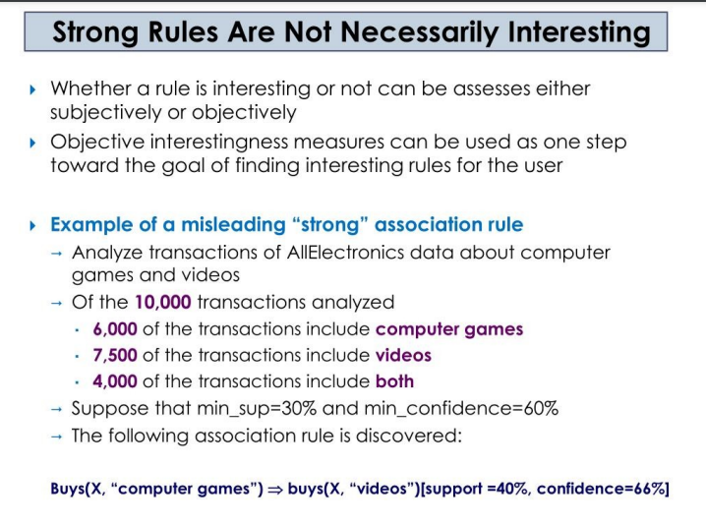
Which patterns are interesting? – Pattern Evaluation Methods

Slide 57
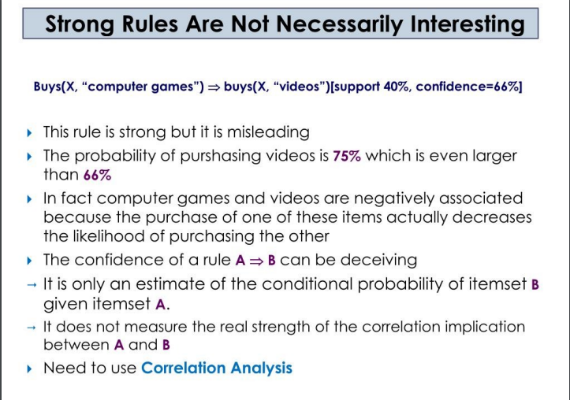

Slide 58
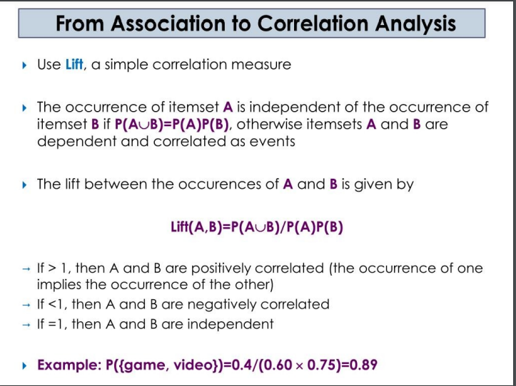

Slide 59
Multilevel Association Rule in data mining
Multilevel Association Rule : Association rules created from mining information at different degrees of reflection are called various level or staggered association rules. Multilevel association rules can be mined effectively utilizing idea progressions under a help certainty system. Rules at a high idea level may add to good judgement while rules at a low idea level may not be valuable consistently.
Utilizing uniform least help for all levels :
At the point when a uniform least help edge is utilized, the pursuit system is rearranged.
The technique is likewise straightforward, in that clients are needed to indicate just a single least help edge.
A similar least help edge is utilized when mining at each degree of deliberation. (for example for mining from “PC” down to “PC”). Both “PC” and “PC” discovered to be incessant, while “PC” isn’t.

Slide 60
Needs of Multidimensional Rule :
Sometimes at the low data level, data does not show any significant pattern but there is useful information hiding behind it. The aim is to find the hidden information in or between levels of abstraction.
Approaches to multilevel association rule mining :
Uniform Support(Using uniform minimum support for all level)
Reduced Support (Using reduced minimum support at lower levels)
Group-based Support(Using item or group based support)

Slide 61
1. Uniform Support –
At the point when a uniform least help edge is used, the search methodology is simplified. The technique is likewise basic in that clients are needed to determine just a single least help threshold.
An advancement technique can be adopted, based on the information that a progenitor is a superset of its descendant. the search keeps away from analyzing item sets containing anything that doesn’t have minimum support. The uniform support approach however has some difficulties.
It is unlikely that items at lower levels of abstraction will occur as frequently as those at higher levels of abstraction.
If the minimum support threshold is set too high it could miss several meaningful associations occurring at low abstraction levels. This provides the motivation for the following approach.

Slide 62
2. Reduce Support – For mining various level relationship with diminished support, there are various elective hunt techniques as follows.
Level-by-Level independence – This is a full-broadness search, where no foundation information on regular item sets is utilized for pruning. Each hub is examined, regardless of whether its parent hub is discovered to be incessant.
Level – cross-separating by single thing – A thing at the I level is inspected if and just if its parent hub at the (I-1) level is regular .all in all, we research a more explicit relationship from a more broad one. If a hub is frequent, its kids will be examined; otherwise, its descendant is pruned from the inquiry.

Slide 63
Level-cross separating by – K-itemset – A-itemset at the I level is inspected if and just if it’s For mining various level relationship with diminished support, there are various elective hunt techniques.
Level-by-Level independence – This is a full-broadness search, where no foundation information on regular item sets is utilized for pruning. Each hub is examined, regardless of whether its parent hub is discovered to be incessant.
Level – cross-separating by single thing – A thing at the 1st level is inspected if and just if its parent hub at the (I-1) the level is regular .all in all, we research a more explicit relationship from a more broad one. If a hub is frequent, its kids will be examined otherwise, its descendant is pruned from the inquiry.
Level-cross separating by – K-item set – A-item set at the I level is inspected if and just if its corresponding parents A item set (i-1) level is frequent.

Slide 64
3. Group-based support – The group-wise threshold value for support and confidence is input by the user or expert. The group is selected based on a product price or item set because often expert has insight as to which groups are more important than others. Example – For e.g. Experts are interested in purchase patterns of laptops or clothes in the non and electronic category. Therefore low support threshold is set for this group to give attention to these items’ purchase patterns.

Slide 65
Data Mining Multidimensional Association Rule
In Multi dimensional association rule Qualities can be absolute or quantitative.
Quantitative characteristics are numeric and consolidates order.
Numeric traits should be discretized.
Multi dimensional affiliation rule comprises of more than one measurement.
Example –buys(X, “IBM Laptop computer”)buys(X, “HP Inkjet Printer”)

Slide 66
Approaches in mining multi dimensional affiliation rules : Three approaches in mining multi dimensional affiliation rules are as following.
1. Using static discretization of quantitative qualities :
Discretization is static and happens preceding mining.
Discretized ascribes are treated as unmitigated.
Use apriori calculation to locate all k-regular predicate sets(this requires k or k+1 table outputs). Each subset of regular predicate set should be continuous.
Example – If in an information block the 3D cuboid (age, pay, purchases) is continuous suggests (age, pay), (age, purchases), (pay, purchases) are likewise regular.
Note – Information blocks are appropriate for mining since they make mining quicker. The cells of an n-dimensional information cuboid relate to the predicate cells.

Slide 67
2. Using powerful discretization of quantitative traits :Known as mining Quantitative Association Rules.
Numeric properties are progressively discretized.
Example –:
age(X, "20..25") Λ income(X, "30K..41K")buys ( X, "Laptop Computer")
3. Grid FOR TUPLES : Using distance based discretization with bunching – This id dynamic discretization measure that considers the distance between information focuses. It includes a two stage mining measure as following.
Perform bunching to discover the time period included.
Get affiliation rules via looking for gatherings of groups that happen together.
The resultant guidelines may fulfill –
Bunches in the standard precursor are unequivocally connected with groups of rules in the subsequent.
Bunches in the forerunner happen together.
Bunches in the ensuing happen together.

Slide 68
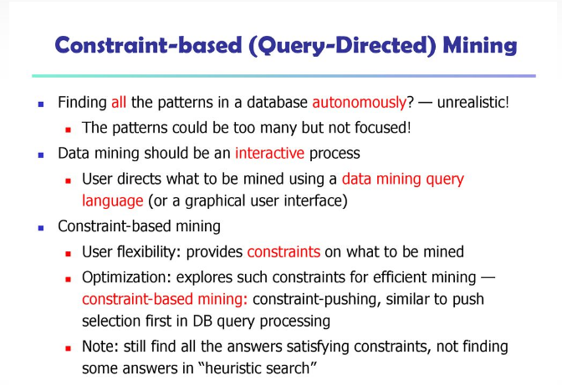
Constraint based frequent pattern Mining

Slide 69
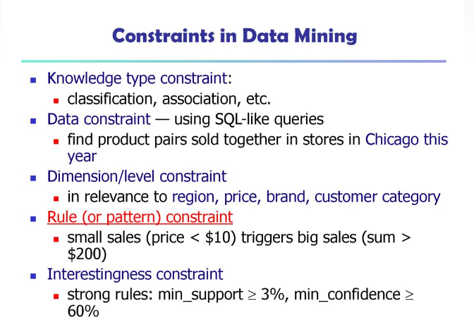

Slide 70
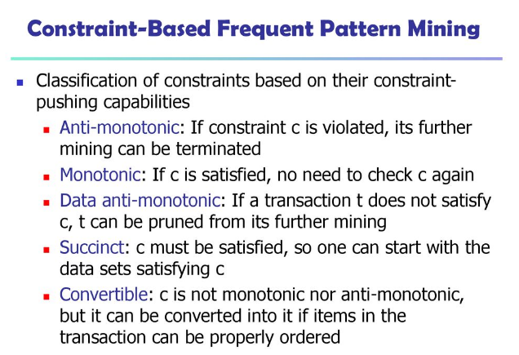

Slide 71
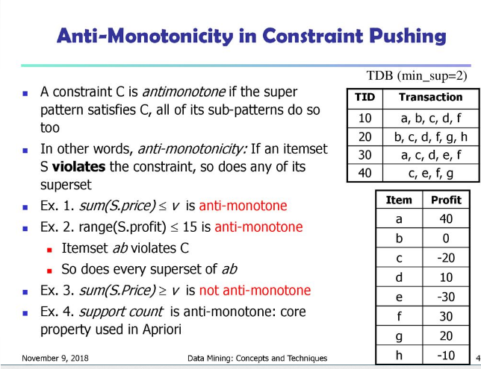

Slide 72
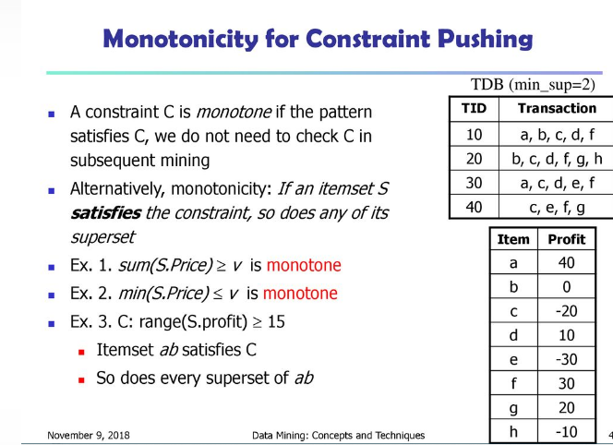

Slide 73
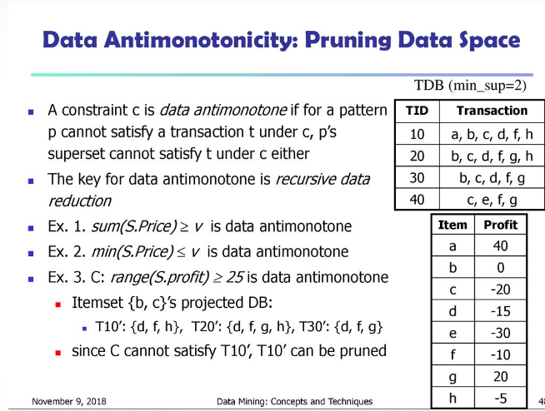

Slide 74
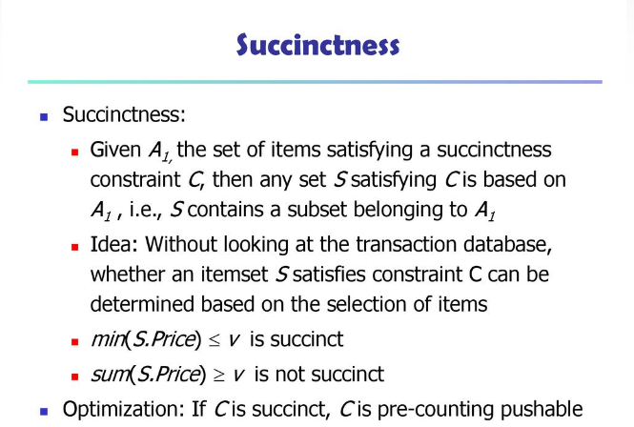

Slide 75
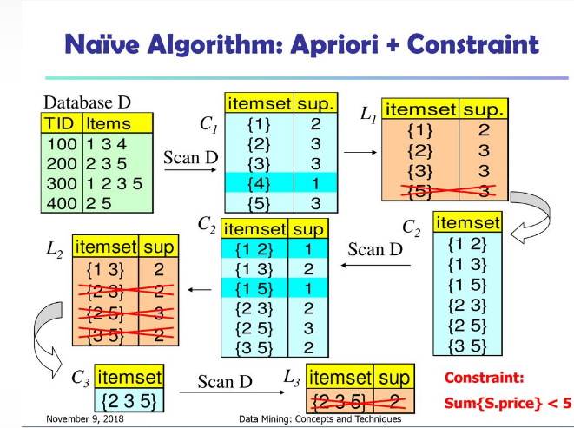

Slide 76
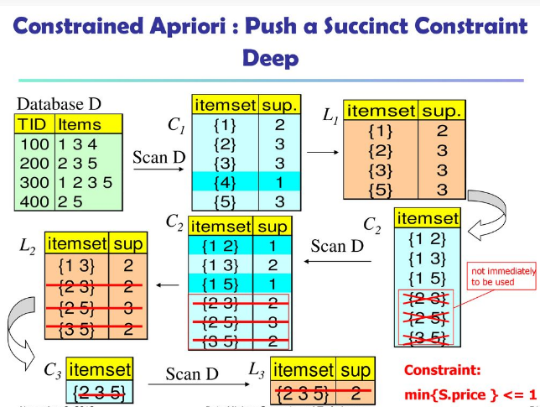

Slide 77
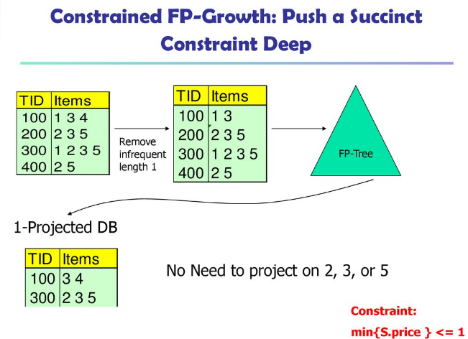

Slide 78
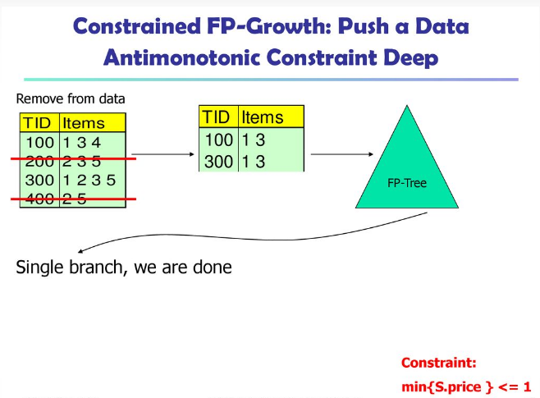

Slide 79
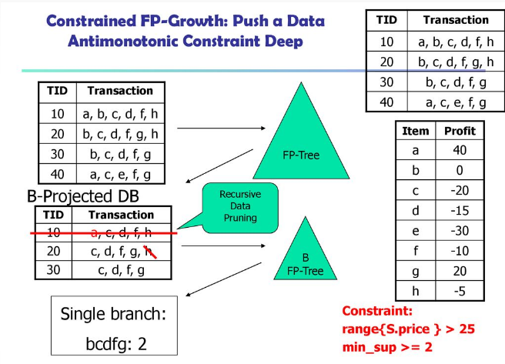

Slide 80
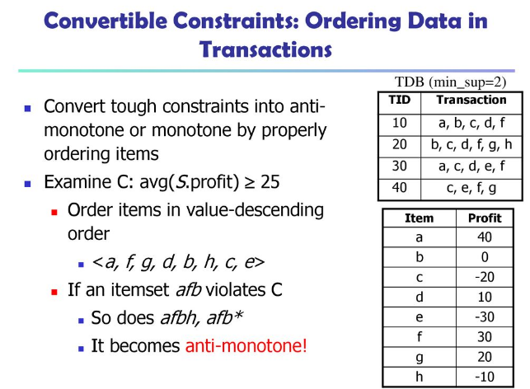

Slide 81
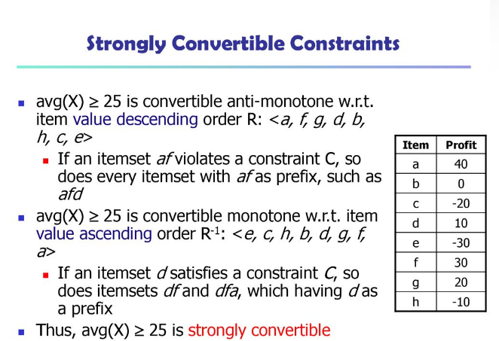

Slide 82
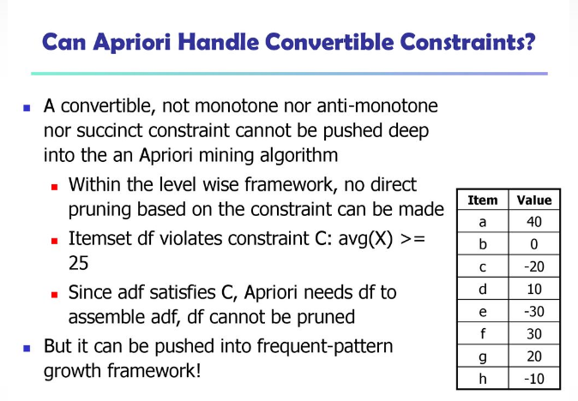

Slide 83
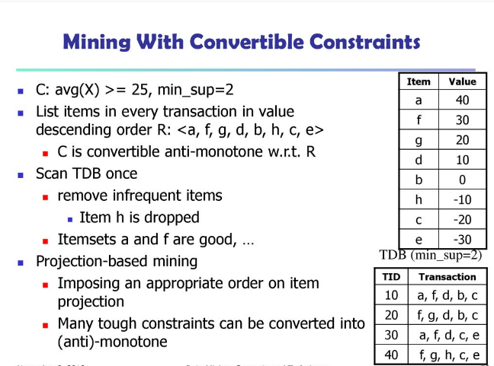

Slide 84
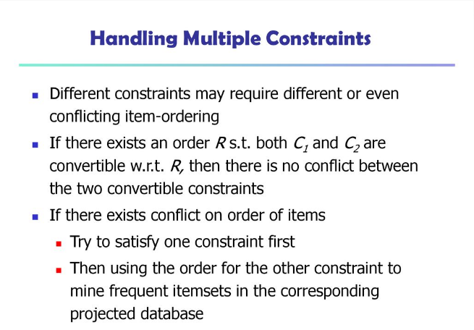

Slide 85
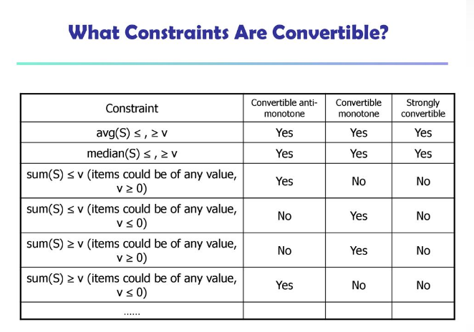

Slide 86
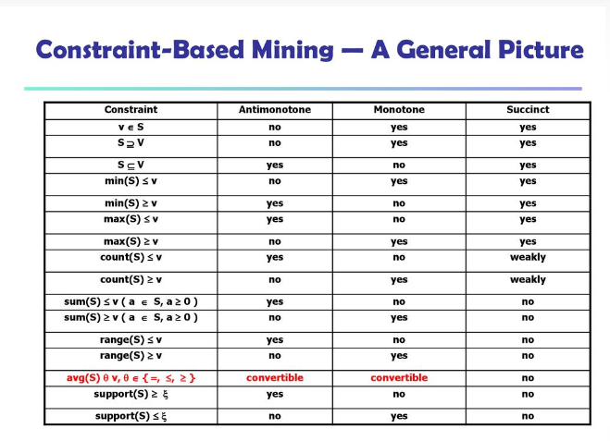

Slide 87
End of Unit III

